Slide 1
www.Healing-Politics.org
Will You Run? You Should!
Nurses & Midwives:
Are under-represented in elected office
Are superb communicators, empathetic listeners, & persistent consensus builders
Bring a unique perspective to politics that can begin to heal what divides us
Healing Politics is on a mission to inspire, motivate, recruit, & train nurses & midwives to run for elected office up & down the ballot while building a culture of civic engagement within the professions
Healing Politics 7/2022

Slide 2
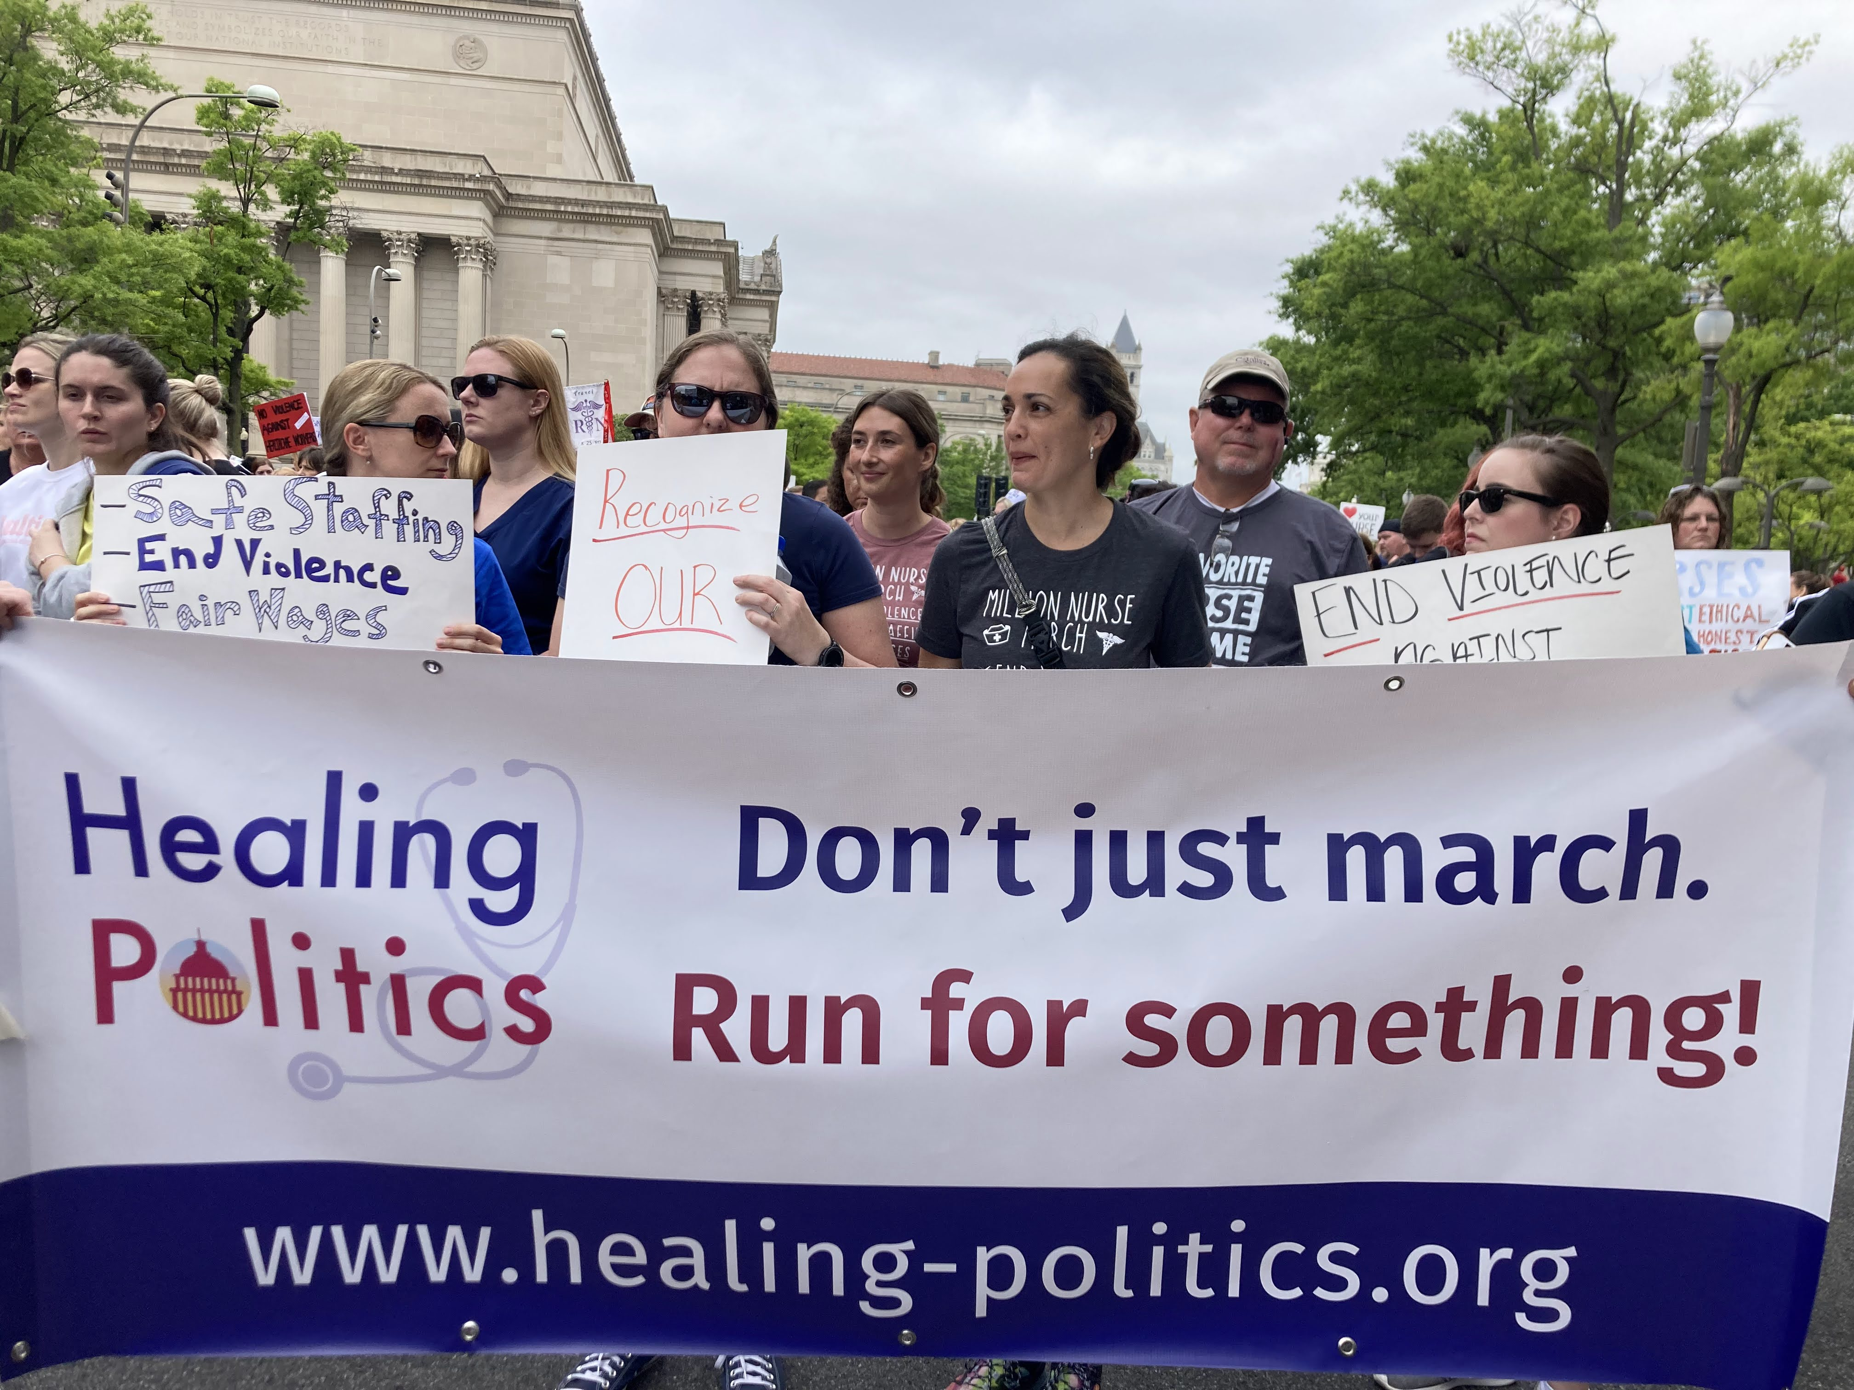
www.Healing-Politics.org
Nurses & Midwives:
Are under-represented in elected office
Are superb communicators, empathetic listeners & persistent consensus builders
Bring a unique perspective to politics that can begin to heal what divides us
Healing Politics is on a mission to inspire, motivate, recruit, & train nurses & midwives to run for elected office up & down the ballot while building a culture of civic engagement within the professions
Healing Politics 7/2022

Slide 3
www.Healing-Politics.org
Healing Politics: Campaign Training & So Much More
Inspire
Inspire nurses & midwives to run for office up & down the ballot
Identify
Identify nurses & midwives who will run & build a community to help them
Provide
Provide non-partisan training & support to help nurses & midwives who run, win
Develop
Develop a database of successful & unsuccessful nurse & midwife candidates at the local, state, & federal level
Partner
Partner with researchers to add to what we know about nurses & midwives in elected office
Healing Politics 7/2022
Notes:
Documentary!

Slide 4
Healing Politics: Campaign Training & So Much More
Inspire
Inspire nurses & midwives to run for office up & down the ballot
Identify
Identify nurses & midwives who will run & build a community to help them
Provide
Provide non-partisan training & support to help nurses & midwives who run, win
Develop
Develop a database of successful & unsuccessful nurse & midwife candidates at the local, state, & federal level
Partner
Partner with researchers to add to what we know about nurses & midwives in elected office
Have you ever thought about running for elected office?
As a nurse or midwife, you already have the skills & expertise needed to run for & serve in local, state, or federal elected office.
Learn more:
www.Healing-Politics.org
Healing Politics 7/2022
Notes:
Documentary!

